Slide 1
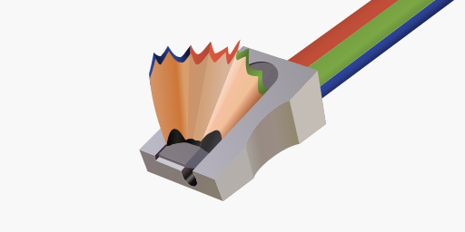
Creating a game before the baby wakes

